Slide 1
Data Privacy Attacks

Slide 2
Introduction
Advancements in information technology (IT) have raised concerns about the risks to data associated with weak IT security.
Inadequate IT security may result in compromised confidentiality, integrity, and availability of the data due to unauthorized access.
To ensure that individual privacy remains carefully protected, local and state education agencies should implement state-of-the-art information security practices.
Staying ahead of the ever-evolving threat of a data breach requires diligence on the part of the education community in understanding and anticipating the risks.

Slide 3
Technical Threats

Slide 4
Non-existent Security Architecture
Some organizations do not have an established security architecture in place, leaving their networks vulnerable to exploitation and the loss of personally identifiable information (PII).
Inadequate network protection results in increased vulnerability of the data, hardware, and software, including susceptibility to malicious software.

Slide 5
Non-existent Security Architecture
If the network contains sensitive information or PII, it is critical that even in a very limited resource environment, minimal user, network and perimeter security protection mechanisms (such as anti-virus) are implemented.
Mitigation: If an organization does not have the appropriate personnel to design a security architecture, it is recommended that a third party be brought in to consult with the IT team.

Slide 6
Un-patched Client Side Software and Applications
Computers run a variety of software applications, including older versions of that may sometimes contain vulnerabilities that can be exploited by malicious actors.
Mitigation: To reduce the ability of malicious actors to compromise or destroy an organization’s security system, implement a robust patch management program that identifies vulnerable software applications and regularly updates the software security to ensure ongoing protection from known threats.

Slide 7
Phishing and Targeted Attacks (“Spear Phishing”)
One way malicious individuals or criminals (e.g., hackers) target individuals and organizations to gain access to personal information is through emails containing malicious code this is referred to as phishing. Once infected emails are opened, the user’s machine can be compromised.
Mitigation:
To reduce vulnerability to phishing and other e-mail security scams, organizations should install professional enterprise-level e-mail security software.

Slide 8
Figure I. Stages in Spear Phishing Attacks

Slide 9
Phishing and Targeted Attacks (“Spear Phishing”)
It is recommended that this software check both incoming and outgoing messages to ensure that spam messages are not being transmitted if a system becomes compromised.
In addition, organizations should provide regular internet security training to staff to ensure user-awareness about e-mail scams.

Slide 10
Internet Websites
Malicious code can be transferred to a computer through browsing webpages that have not undergone security updates.
Simply browsing the internet and visiting compromised or unsecured websites could result in malicious software being downloaded to an organization’s computers and network.
Mitigation: To prevent threats from compromised websites, employ firewalls and antivirus software to help identify and block potentially risky web pages.

Slide 11
Poor Configuration Management
Any computer connected to the network, whether at work or at home, that does not follow configuration management policy, is vulnerable to an attack.
Weak data security protection measures that do not restrict which machines can connect to the organization’s network make it vulnerable to this type of threat.

Slide 12
Poor Configuration Management
Mitigation:
Establish a configuration management policy for connecting any hardware to the network.
The policy should specify security mechanisms and procedures for various types of hardware, including computers, printers, and networking devices.
It is also recommended to implement a Network Access Control solution to enforce configuration policy requirements.

Slide 13
Mobile Devices
Use of mobile devices, such as laptops or handheld devices, including smartphones, is exploding; however, the ability to secure them is lagging behind.
Data breaches can occur in a number of ways: devices can be lost, stolen, or their security can be compromised by malicious code invading the operating system and applications.

Slide 14
Mobile Devices
Mitigation:
To promote data security in case a device is lost or stolen, encrypt data on all mobile devices storing sensitive information.
Until more data encryption, user authentication, and anti-malware solutions become available for mobile devices, the best protection strategy is to implement a strict mobile device usage policy and monitor the network for malicious activity.

Slide 15
Cloud Computing
In cloud computing large amounts of customer data are stored in shared resources, which raises a variety of data encryption and availability issues.
Further, the cloud provider faces the same data security responsibilities and challenges as the organization that owns the data, including patching and managing their applications against malicious code.
Mitigation:
Conduct an assessment to compare benefits from adopting cloud computing, including cost savings and increased efficiency, against associated security risks.

Slide 16
Cloud Computing
It is critical to ensure that solutions offered by the cloud provider effectively comply with the organization’s information system security requirements, including operational and risk management policies.

Slide 17
Removable media
The use of removable media on an organization’s network poses a significant security threat.
Without proper protection, these types of media provide a pathway for malware to move between networks or hosts.
Following proper security measures when using removable media devices is necessary to decrease the risk of infecting organization’s machines or the entire network.

Slide 18
Removable media
Mitigation:
To minimize the security risks, apply simple preventative steps. These include disabling the “auto run” feature of the operating system on the organization’s machines and training users to scan removable media for viruses before opening the files.

Slide 19
Botnets
Botnets are networks of compromised computers used by hackers for malicious purposes, usually criminal in nature.
Clean up efforts resulting from botnet infestation may be costly and damaging to an organization’s reputation.
Mitigation:
Since there are many ways computers can become compromised, having a strong security architecture is critical to defending against a malicious botnet attack.

Slide 20
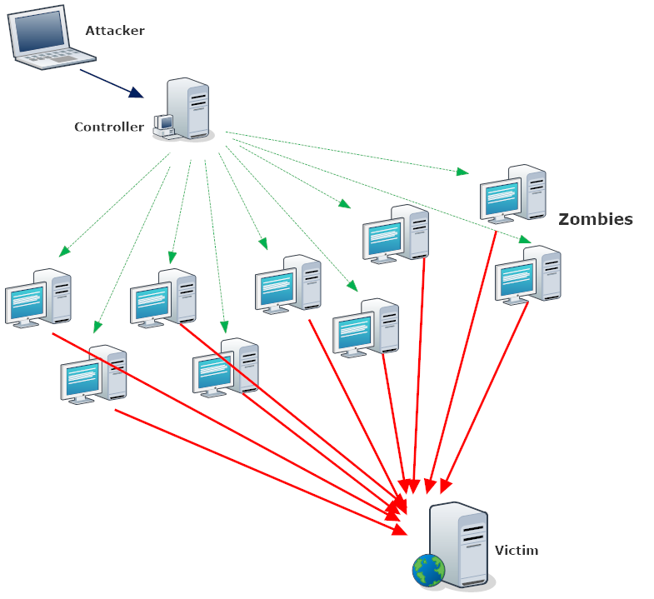
Figure II. Botnet Attack [2]

Slide 21
Botnets
Strategies for botnet detection involve analyzing patterns of data sent over the network, and monitoring computer resources usage and external connections.

Slide 22
Zero-day Attacks
A zero-day attack is a threat aimed at exploiting a software application vulnerability before the application vendor becomes aware of it and before the vulnerability becomes widely known to the internet security community.
These attacks are among the hardest to mitigate and leave computers and networks extremely vulnerable.

Slide 23
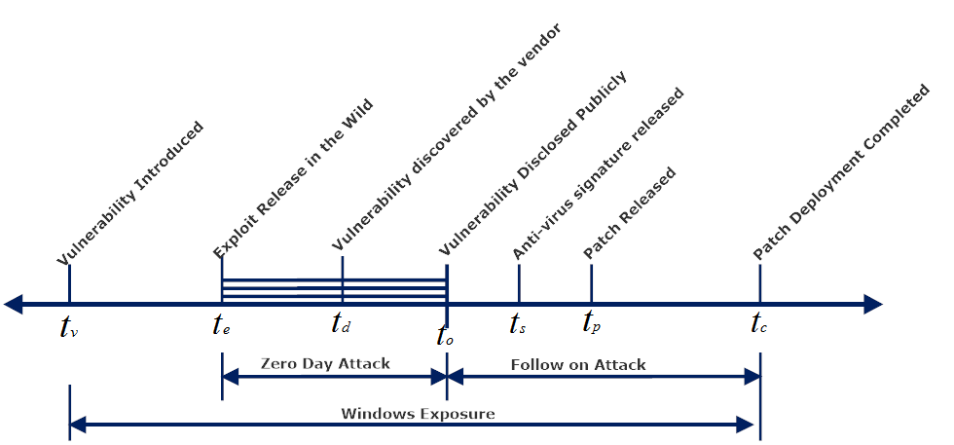
Figure III. Timeline of a Zero-day attack [3]

Slide 24
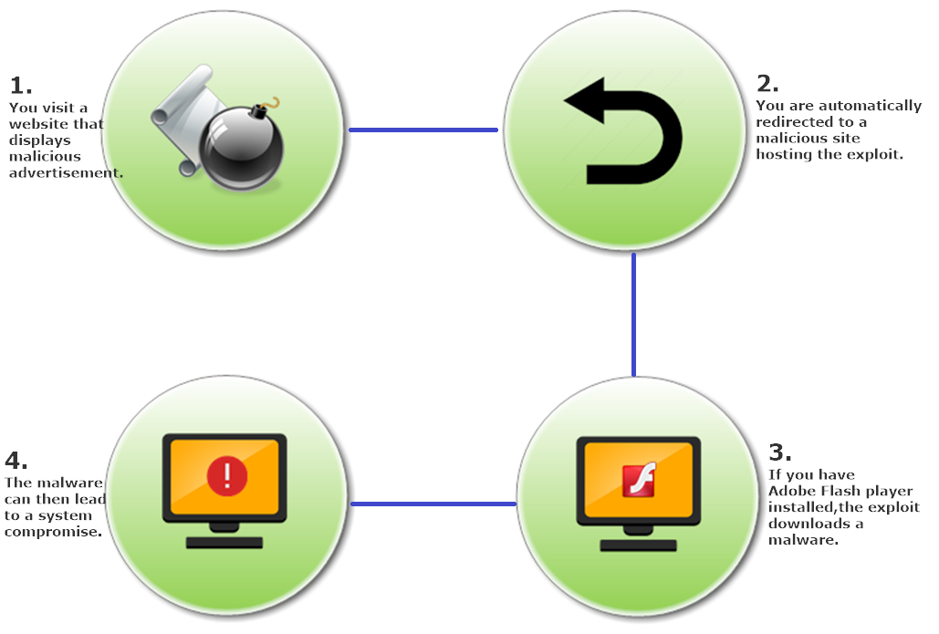
Figure IV. Zero-day Malware Attack on Adobe Flash Player [4]

Slide 25
Zero-day Attacks
Mitigation:
Unless an organization has access to IT analysts who are highly experienced in technical vulnerability assessment, a frequently recommended approach to mitigation is to wait for the vendor to release a patch that fixes the vulnerability.
The organization should keep abreast of the latest software patches and deploy the fix as soon as it is distributed by the developer.

Slide 26
Non-technical Cyber Security Threats to Information Systems

Slide 27
Insider Threats
An insider is defined as someone with legitimate access to the network.
Because information accessed by insiders can be easily stolen, copied, deleted, misfiled, or changed, insider threats can be some of the most damaging, regardless of whether they occur due to user carelessness or malicious attempts.

Slide 28
Insider Threats
Mitigation:
To mitigate this type of threat, establish and enforce a well-defined privilege rights management system.
Audit programs are useful in enforcing access controls and monitoring suspicious activity.

Slide 29
Poor Passwords
Implementing a policy on strong user passwords is critical to data protection.
Modern password-cracking programs can easily break weak passwords, such as those containing common words or word groups found in a dictionary.
For this reason, user-selected passwords are generally considered to be weaker than randomly-generated passwords.

Slide 30
Poor Passwords
Mitigation:
Use a professional password-generating program as an enterprise-level solution.
In addition to implementing procedures for generating strong passwords, train users on how to maintain the security of their passwords.
For enhanced security, consider implementing more advanced authentication capabilities, such as multi-factor authentication.

Slide 31
Physical Security
Physical security is essential to preventing unauthorized access to sensitive data as well as protecting an organization’s personnel and resources.
A Physical safety measures include securing access to dedicated computers, server rooms, routers, printers, and any areas that process or store sensitive data.

Slide 32
Physical Security
Mitigation:
Establish and enforce a physical security system.
Strong physical security includes access control policies and procedures; physical barriers surveillance and alarm systems; and security breach notification, response, and system recovery procedures.

Slide 33
Insufficient Backup and Recovery
Lack of a robust data backup and recovery solution puts an organization’s data at risk and undermines the effectiveness of its IT operations.
Data and system recovery capabilities allow an organization to reduce the risk of damage associated with a data breach.

Slide 34
Insufficient Backup and Recovery
Mitigation:
Establish an organizational policy and specify procedures for data backup, storage, and retrieval.
Many advanced data and system backup and recovery tools are available on the market.

Slide 35
Improper Destruction
Discarded electronic devices, such as computers or portable drives, that have been used in processing and storing sensitive data, remain vulnerable unless the data are erased properly.
A data breach can occur if recovery tools are used to extract improperly erased or overwritten data.

Slide 36
Improper Destruction
Mitigation:
Establish a policy for protecting or destroying no longer needed IT assets and media that may contain sensitive data.
Several standards organizations offer guidelines that outline best practices for ensuring data are discarded properly, including recommendations published by the National Institute of Standards and Technology (NIST) titled NIST SP 800-88, “Guidelines for Media Sanitization.”

Slide 37
Social Media
Using organization’s devices and network resources to access social media websites poses a high data security threat.
Social networking sites are often targeted by malware, receive a high degree of spam, and are frequently used to gain information for identity theft.
Mitigation:
Introduce and reinforce a policy forbidding access to some social media websites while using an organization’s resources and equipment.

Slide 38
Social Media
Train users about the security threats generated by visiting these sites.
Organizations that allow access to social media websites should deploy a strong anti-virus and spam filtering solution.

Slide 39
Conclusion
Understanding the vast array of threats is the first step in ensuring adequate protection of sensitive data.
All networks are vulnerable to cyber security threats.
A comprehensive data security program is essential for mitigating these threats and preventing a data breach.
A holistic approach to data security begins with understanding the network, its architecture, user population, and mission requirements.
Consistent implementation of the security plan will reduce susceptibility to cyber threats and increase the overall security of an organization’s data.

Slide 40
References
[1] | Privacy Technical Assistance Center USA, “Data Security: Top Threats to Data Protection ”, pdf available at: http://ptac.ed.gov/sites/default/files/issue-brief-threats-to-your-data.pdf, Last accesssed: August 2016.
[2] | HelpSec, “Malware-infected home routers used to launch DDoS attacks”, available at: http://www.helpsec.net/malware-infected-home-routers-used-to-launch-ddos-attacks, Last accesssed: August 2016.
[3] | InfoSec, “Wrong response to zero day attacks exposes serious risks”, available at: http://www.infosecisland.com/blogview/22600-Wrong-response-to-zero-day-attacks-exposes-serious-risks.html, Last accesssed: August 2016.
[4] | Trend Micro, “Malicious Ads Redirect to Flash Zero-Day Exploit, Affects Top Video-Sharing Site”, available at: http://www.trendmicro.com/vinfo/us/security/news/cybercrime-and-digital-threats/malicious-ads-redirect-to-flash-zero-day-exploit-affects-top-video-sharing, Last accesssed: August 2016.
[5] | BCS, “Top 10 database attacks”,available at: http://www.bcs.org/content/ConWebDoc/8852, Last accesssed: August 2016.

